Slide 1
Project 04 Presentation
Derek Fritz

Slide 2
Battleship – The Board Game
Battleship is a classic board game in which two players take turns trying to sink all of their opponent's ships
Before the game begins, each player privately places their ships on the board in any position or orientation they wish
Each turn consists of one player targeting a coordinate on their opponent’s board (e.g. A-3, G-10), and the opponent stating whether it was a hit or a miss
The player then marks the result on their own board and the other player starts their turn

Slide 3
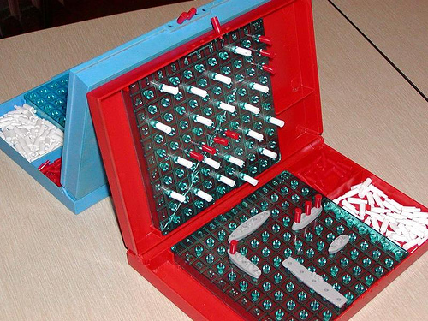
Battleship – The Board Game

Slide 4
Battleship – My Implementation
In the version of Battleship that I created, the game is played against a computer opponent
Both the player’s and the computer’s ships are randomly placed before the game begins
The game board is presented in a graphical user interface, where every coordinate is represented as a cell which can be selected
A history of both the player’s and the computer’s actions are displayed in a text box that is part of the user interface

Slide 5
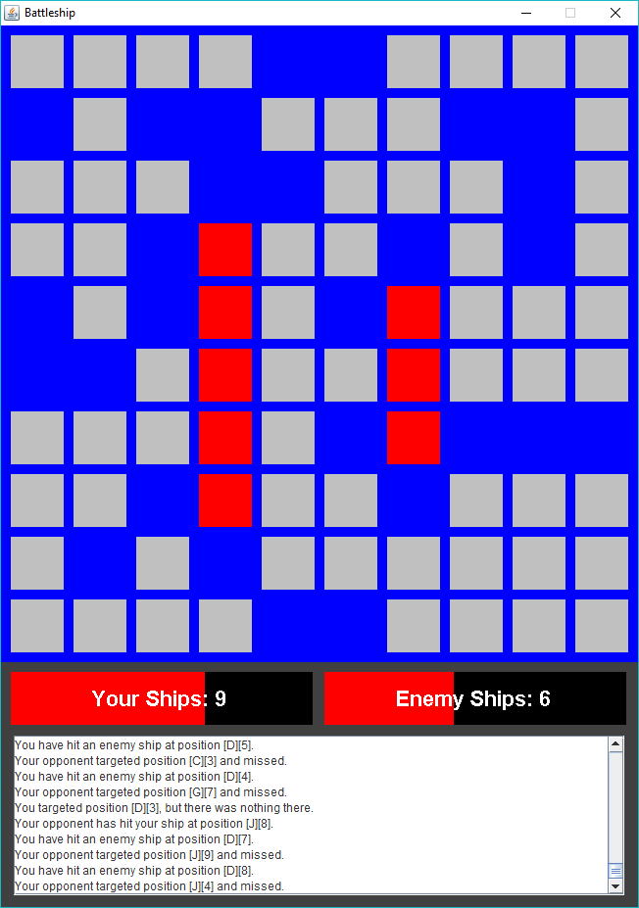

Slide 6
Implementation Features
I used a combination of the awt and swing libraries to create the user interface
AWT (Abstract Window Toolkit) – Used primarily for painting the basic graphical components of the UI
Swing – Used in creating the window itself and the more complex UI components, such as the text display and menu buttons.
I also used the MouseMotionListener and MouseListener interfaces in order to allow for direct user interaction with the graphical components created

Slide 7
Implementation Features – Components
The main parts of the game’s implementation include:
The window
The board
The text display
The endgame menu
The information variables (ship arrays, menu status, etc.)
The mouse/action listeners

Slide 8
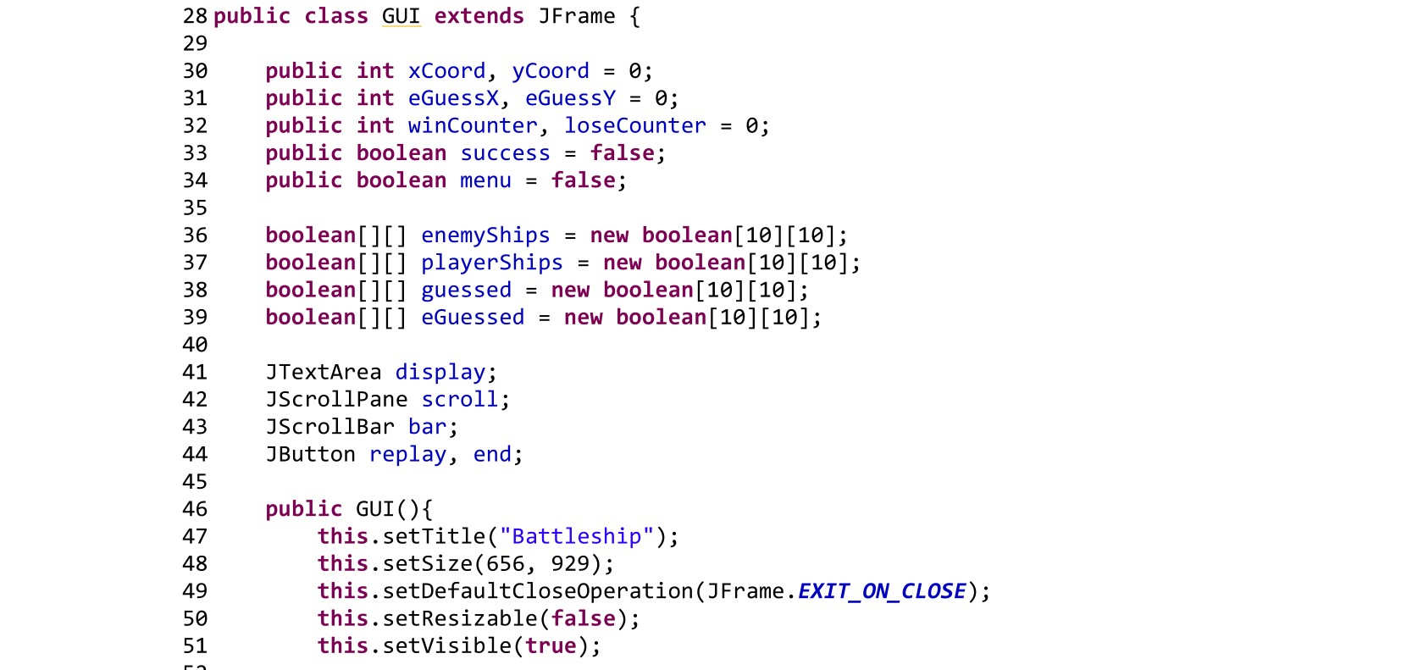
Components – Window
The window itself is a JFrame object with its traits defined in the constructor of my GUI class

Slide 9
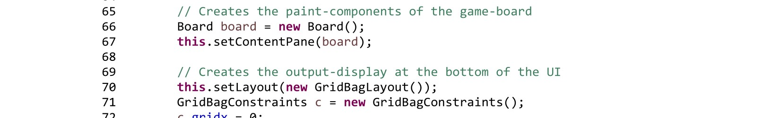
Components - Board
The board is represented as its own class, which is also a nested class inside of GUI
It extends JPanel, and its active instance is set as the window’s content pane, allowing further components to be added
The Board class contains one method, paintComponent, which creates all of the board’s awt components such as the coordinate cells and player health bars

Slide 10
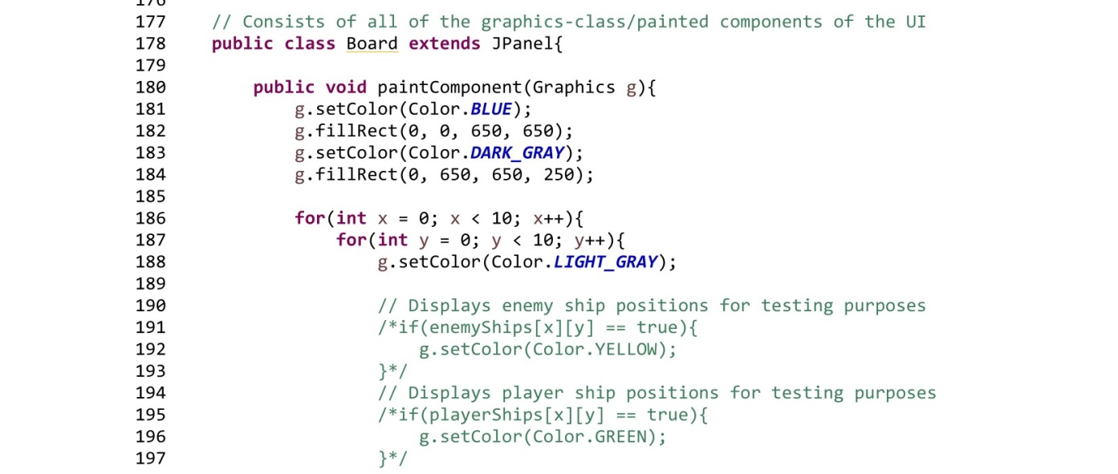
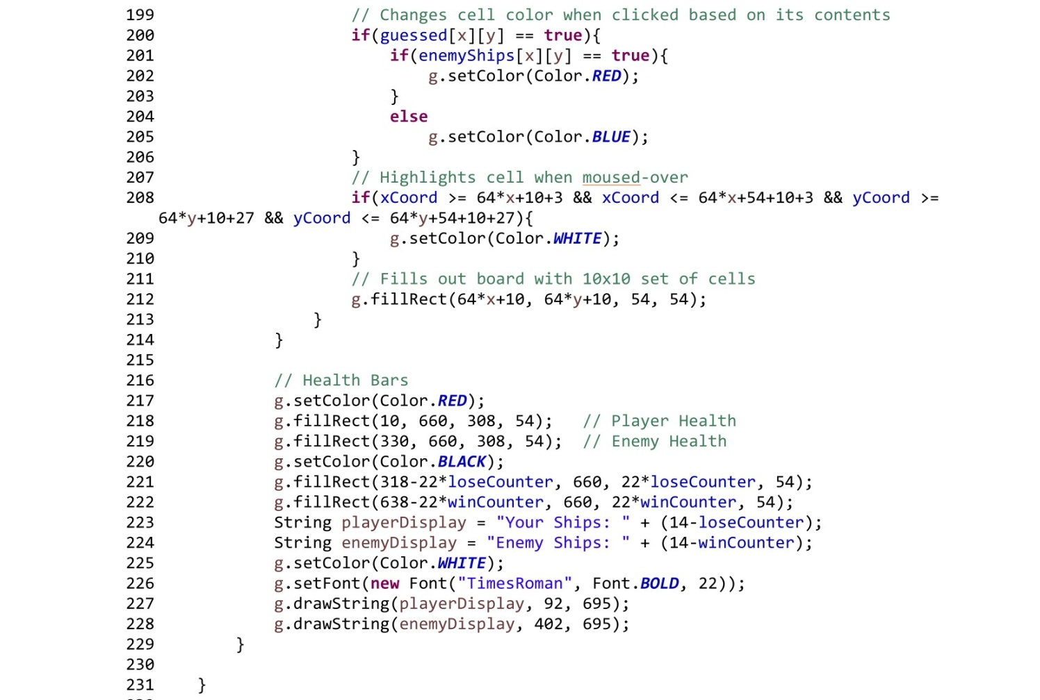

Slide 11
Components – Text Display
The text display is a JTextArea, a swing component that is added to the content pane
A JScrollBar is also applied to it, allowing for vertical scrolling
It was formatted into the window using a GridBagLayout with custom insets
Text is writen to the display using a separate method I wrote, appending the given string to the existing text in the Text Area and creating a new line

Slide 12
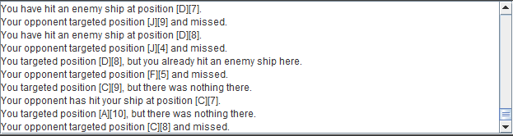

Slide 13
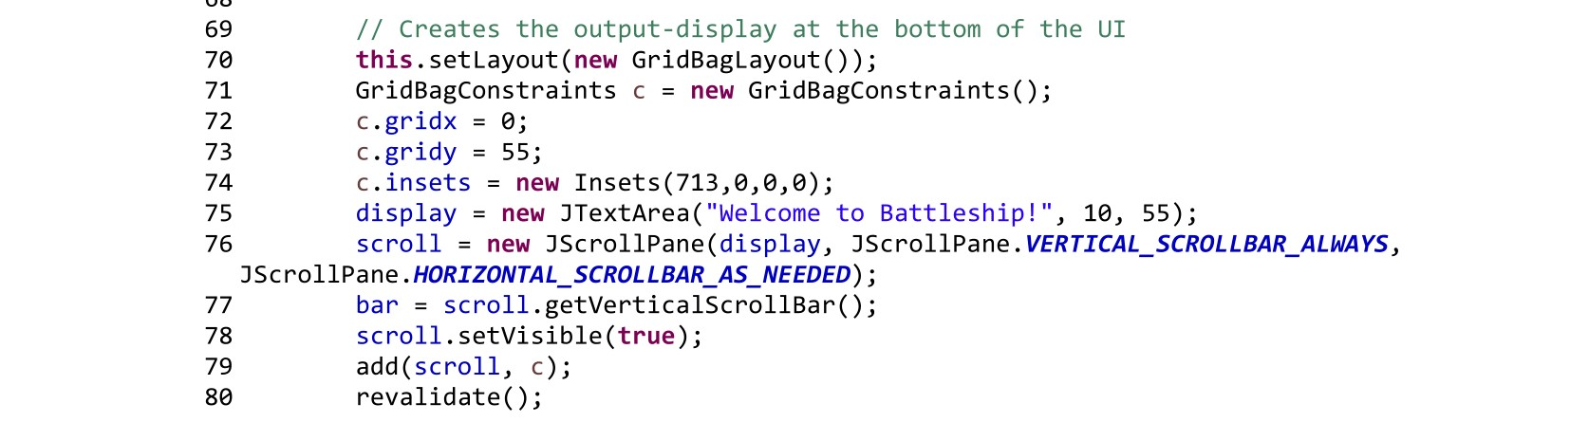
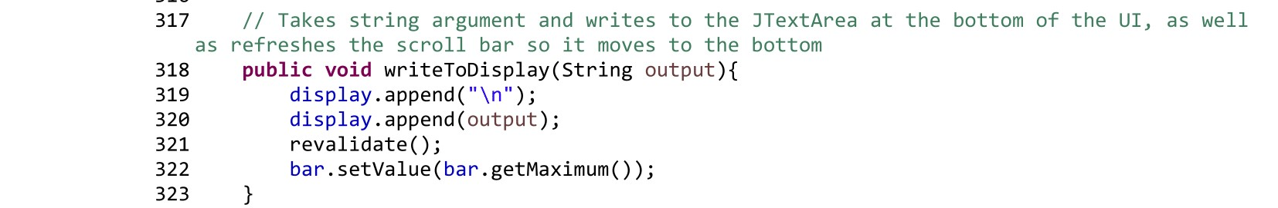

Slide 14
Components – Endgame Menu
The “menu” displayed upon either victory or defeat consists of a pair of JButtons
Each button is created during the creation of the GUI and is only displayed once the endgame conditions are met, hiding the text display at the same time
Action listeners are created for both buttons upon endgame, tying the “Play Again” button with restarting the window and the “End Game” button with terminating the program

Slide 15
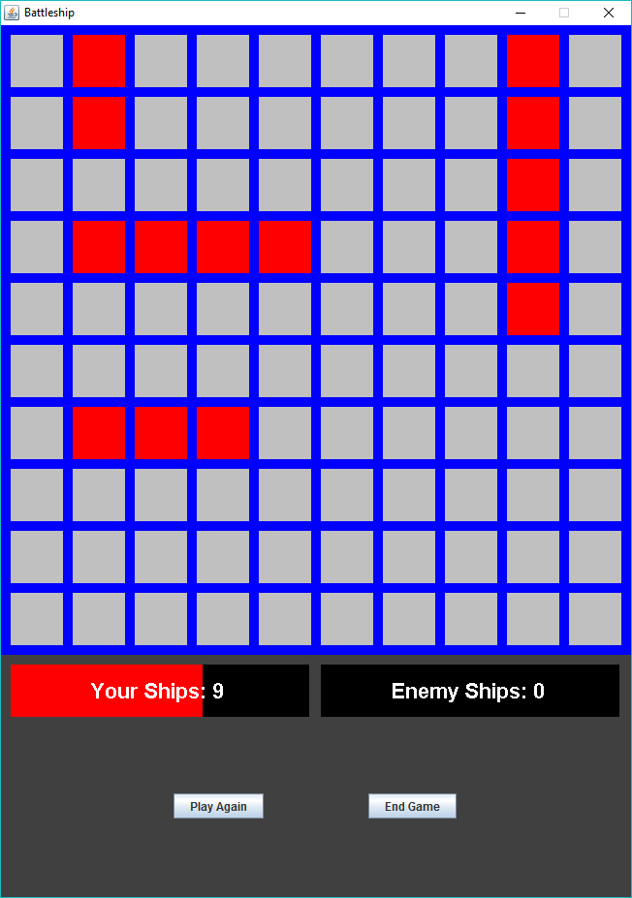

Slide 16
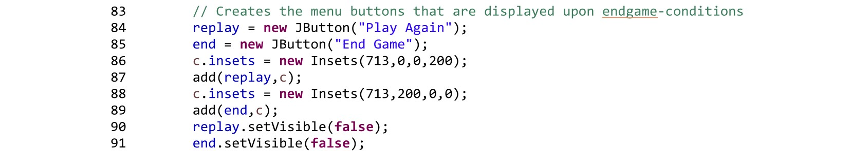
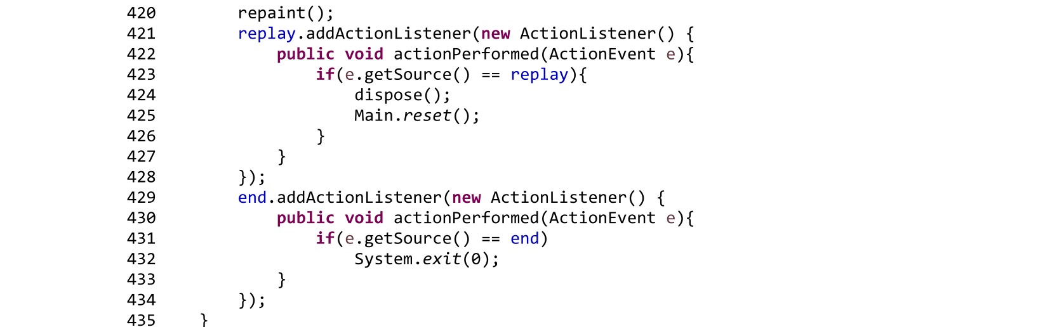

Slide 17
Components – Information Variables
A collection of variables are used to keep track of background information of the game
Two-dimensional arrays act as copies of the game board, and store information on which coordinates contain ships and which cells have been revealed/guessed
Win/Loss counters keep track of how many ships have been sunk for both sides
A menu variable keeps the endgame menu hidden until endgame conditions are met
A guess-success variable allows the computer to make better guesses when correct guesses are made in succession

Slide 18
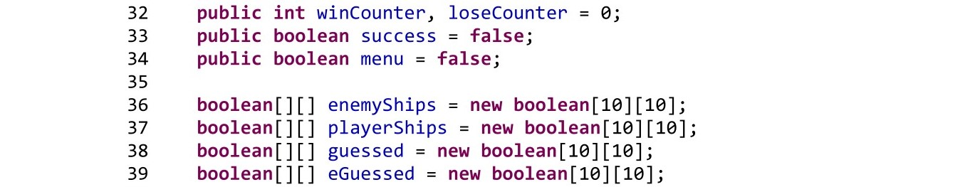

Slide 19
Components – Mouse Listeners
I have two classes that implement Mouse and MouseMotion listeners
The only functions from these interfaces that are used are mouseMoved and mouseClicked
mouseMoved continually updates the xCoord and yCoord variables that are used throughout the program
mouseClicked acts as the “player turn” action, checking the coordinates of the clicked cell and referencing the information arrays to determine the results

Slide 20
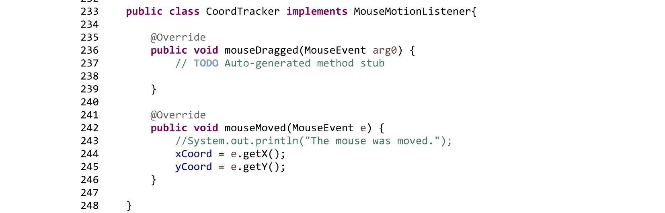

Slide 21
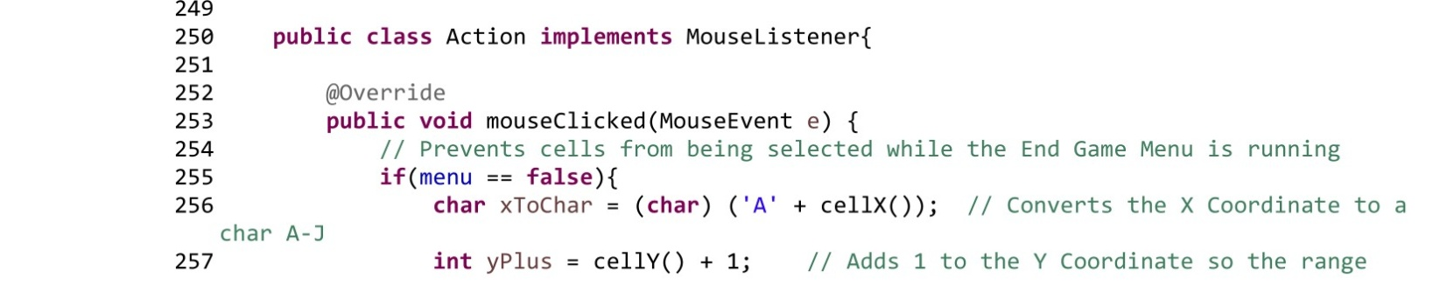
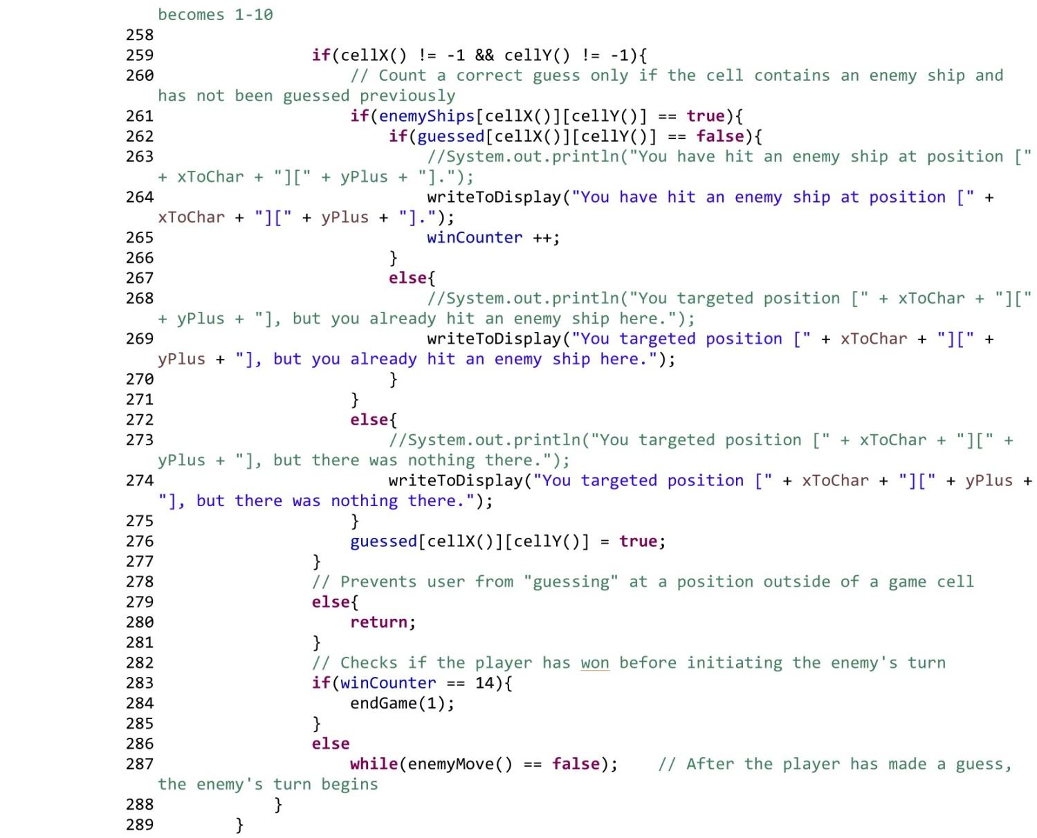

Slide 22
Game Mechanics
There are three main features of the game’s mechanics and their implementations:
Pre-game setup
Enemy turn logic
End-game conditions

Slide 23
Mechanics - Setup
When the GUI is initially constructed, two loops call the shipPlacement method to create the randomized placement of the player and enemy ships
The shipPlacement method uses two randomized pieces of information:
A randomized set of coordinates to act as the initial cell of the ship
A randomized direction (0-3) for the ship to be positioned in
The function attempts to place the ship in the determined cells, and either successfully does so or runs into another ship
If the method recognizes that the ship placement conflicts with another ship placed, it resets the placement and returns false, triggering another attempt

Slide 24
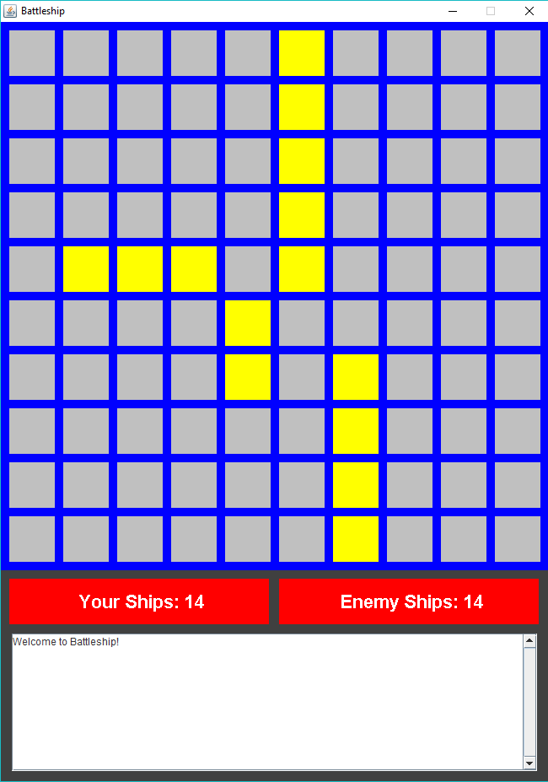
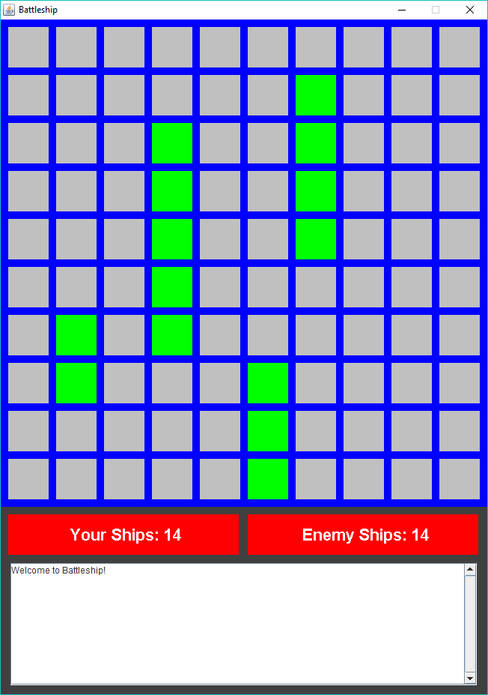

Slide 25
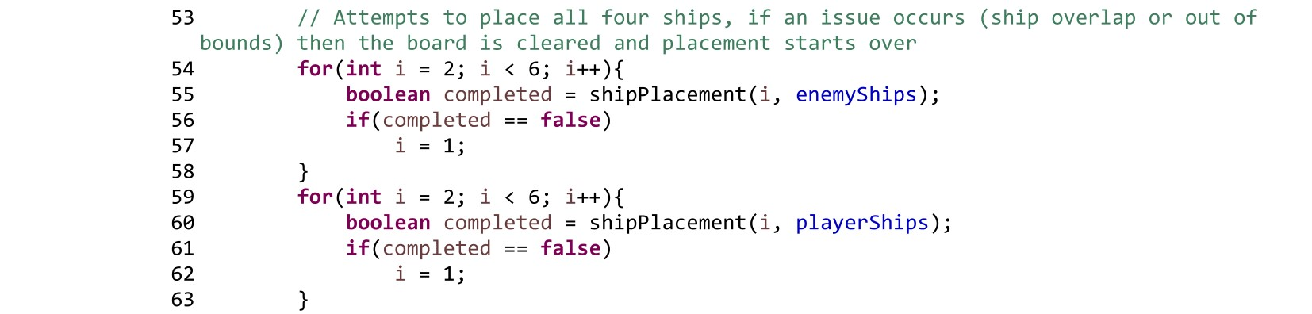

Slide 26
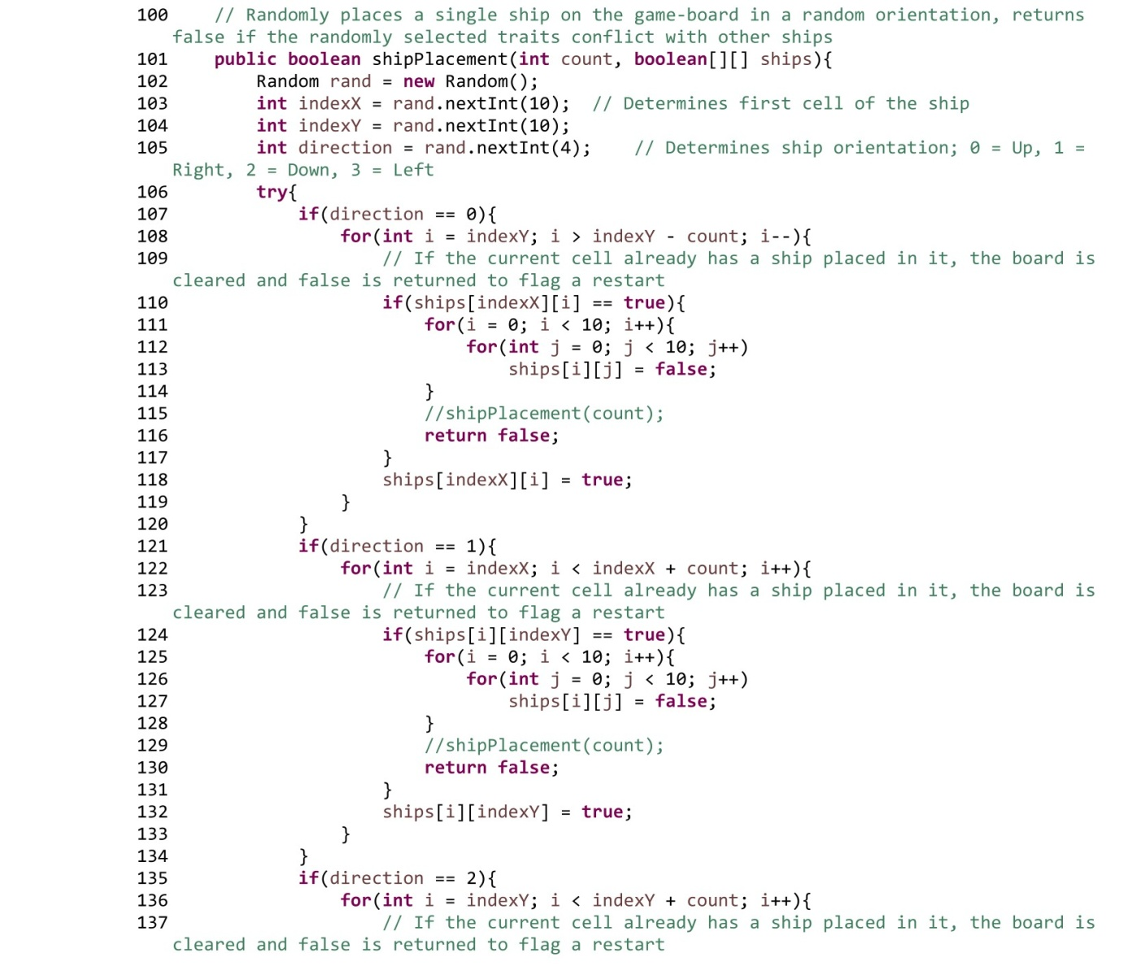
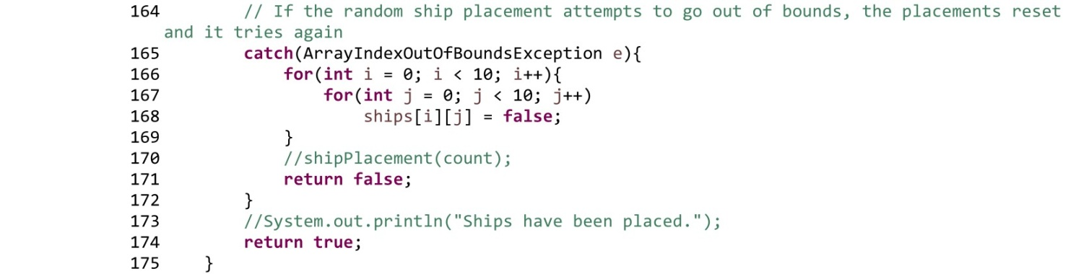

Slide 27
Mechanics – Enemy Turn
The enemy turn consists of a similar process, utilizing both the same random coordinate and direction generation
The default “guessing” strategy for the computer is to simply target a random coordinate that hasn’t already been targeted
Once the computer hits a player ship, a success flag is triggered and the computer makes an educated guess the following turn
This consists of taking the previous coordinate and stepping out one cell in a random direction

Slide 28
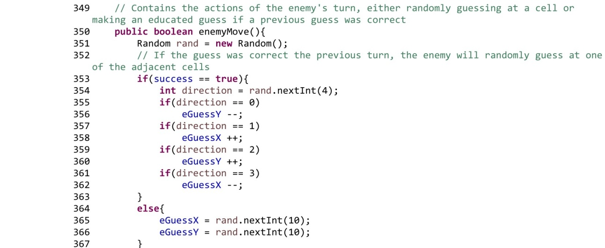
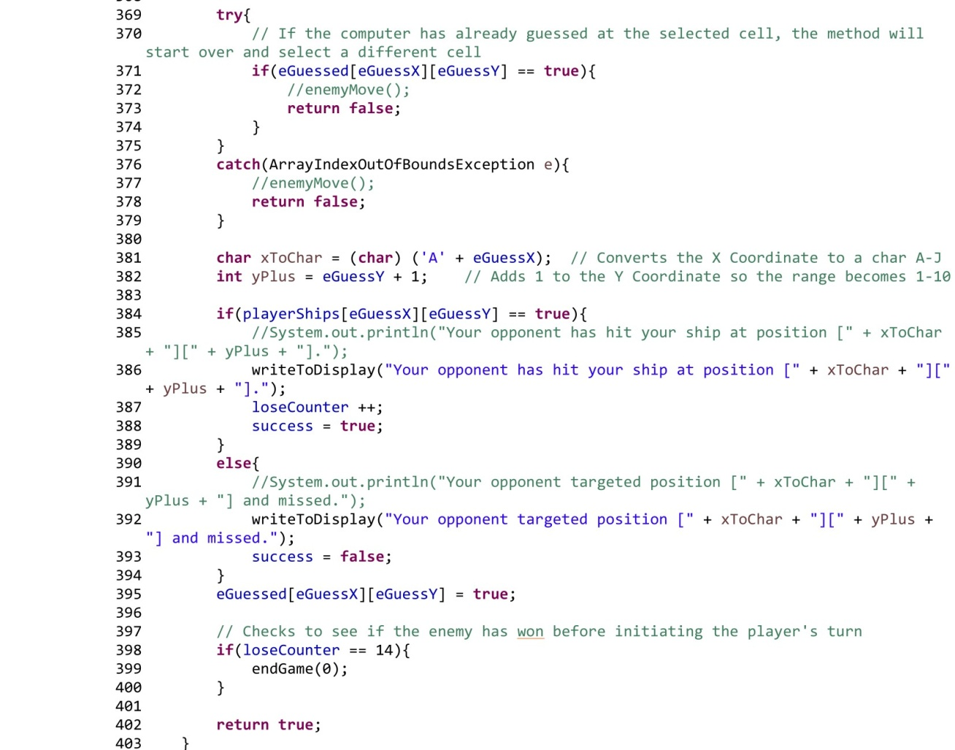

Slide 29
Mechanics - Endgame
Once either the win counter and lose counter reach 14 (the total ship cells for a player), the endGame method is called and prints a victory or loss message
The endgame menu is then activated and the text display is deactivated until the user decides to play again or exit the game

Slide 30
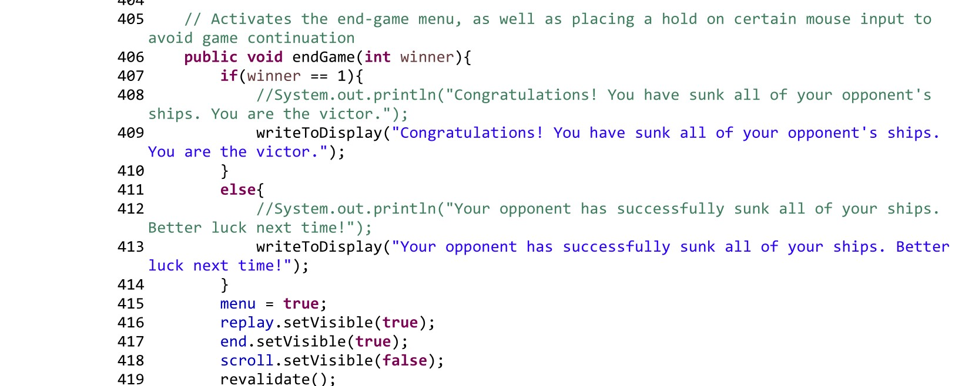

Slide 31
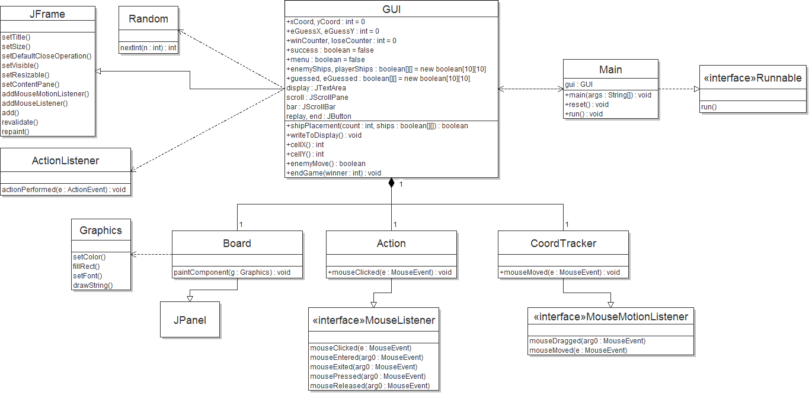
UML Class Diagram

Slide 32
Now for a quick demo

